Slide 1
ItsRPM _{the automotive social media}

Slide 2
problem
There is no dedicated community or a forum for an indian petrolhead/automotive enthusiast,theirs a lot of worthy content but is separated in terms of websites with very poor interfaces.

Slide 3
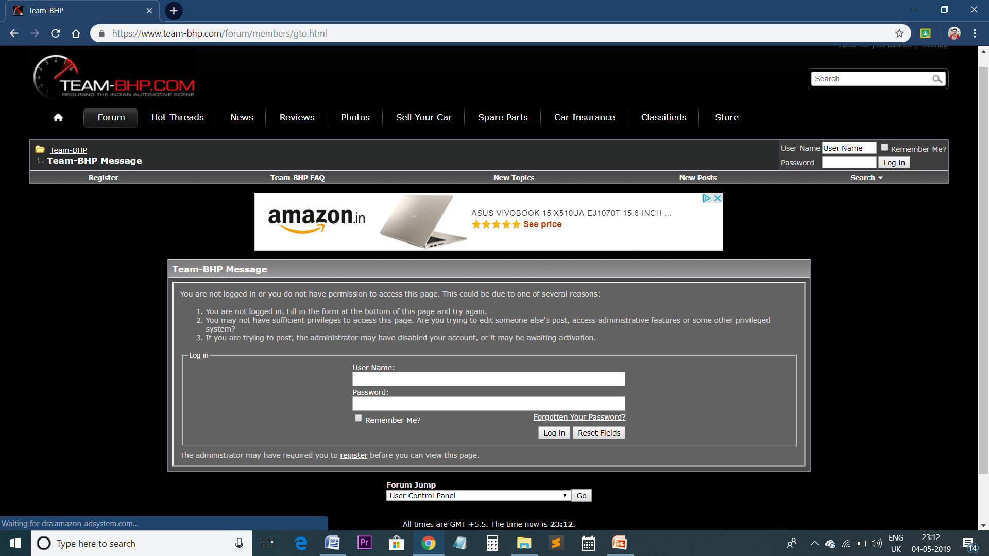
INTERFACE OF TEAMBHP

Slide 4
solution
Making a application and website which is both for a indian car enthuisiast as well as a new car buyer,or in simple terms social media of cars

Slide 5
USP
This would be first of its kind social media app in terms of automotive,in simple terms facebook,instagram of cars

Slide 6
TARGET AUDIENCE
Indian automotive enthusiast and new car buyers

Slide 7
CUSTOMER SURVEY
More than 25 people were surveyed about this model on the basis of three question and the majority answers were
Q1-what do you think about it as a user?
ANS-enthusiast were really very excited about this but normal people with no interest in cars only looked upon the new car buying feature and the expert review
Q2-what did you like the most in the model?
ANS-enthusiast(content creaters) loved the interface,concept and the easy nature of posting daily updates with their users and on the other hand normal people loved the content of the creaters.
Q3-did you know any other website with similar approach?
ANS-ditto copy-NO but many websites offer new car buying feature.

Slide 8
COMPETITIVE ANALYSIS
 | ItsRPM | teamBHP | carwale
New car buying guide | YES | NO | YES
Personel user stories and reviews | YES | YES | NO
Proper fan following account | YES | NO | NO

Slide 9
REVENUE MODEL
NO GOOGLE ADSENSE
----------------------------------------------------------------------------------------
If we talk about a new car buyer, per month in india 1.05 lakh cars are sold. Now when we talk of a indian car buyer,on a average that person searches about numerous or simply uncountable times for at least a month...now just think about the market opportunity because when a guy buys a car,even his family members search about the product numerous times.
Let 2 members of 20k of that families come to our website/app and per month daily i. e.40k visits per day just from buy new car section

Slide 10
REVENUE MODEL
If we talk about an indian automotive enthisiast, it is evident on youtube that how much people have craze of their rides,sharing facts about it,their trips and also people love to give suggestions to people and also share their knowledge about automotives and in return also they get a tremendous response.
Now consider their are 7 top class content creators(with more than 50k followers on their ItsRPM handle)and many other creators also and regularly main ones are posting and getting 15k hits per day per account.
Now that sums upto 105 hits per day
SO IN TOTAL 40K+105K=145k VISITS PER-DAY

Slide 11
REVENUE MODEL
Now as estimated earliar,we are getting 145k hits daily.
Now these stats will be shown to car brands and two day deal would be signed in which we would display the car on the front pages,sides,on loading pages and suggestions and in return get 10k per day from the brand.
Now if we get advertisement for 20 days,it would result to 200k per month

Slide 12
Value proposition
Website and app making(every thing included) -150k
content writers-50k p.m
Technical person-20k p.m
Promotions or marketing 100k

Slide 13
WORKING
An individual account will be made which would show the followers of that person public but the following will be private.
The person can share there personal views,reviews,trips,youtube links,experiences and what not about the automotives
They can comment on other’s posts,also can debate on a topic

Slide 14
MARKETING
There are 15-20 top automotive content creators in india
Now they would be explained the working of this model and would be convonced how thisn platform can change the indian automotive scene and how enrolling on this platform would actually help them only

